Slide 1
Executables and Paths

Slide 2
What is an Executable?

Slide 3
How do we run Executables?

Slide 4
Where are executables located?

Slide 5

How are executables found?

Slide 6
The PATH variable
Windows
Linux
User and System

Slide 7
Inspecting the PATH
Windows & Linux demo

Slide 8
What if something isn’t on the PATH?

Slide 9
Virtual Environments

Slide 10
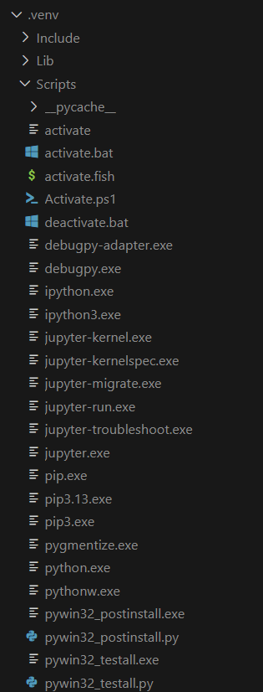
Inspecting the virtual environment
Built to help manage “dependency hell”
Creates a folder inside your directory
Copies over executables and “site-packages”
Creates some scripts and config for later use

Slide 11
VS Code

Slide 12



…can get you in trouble

Slide 13
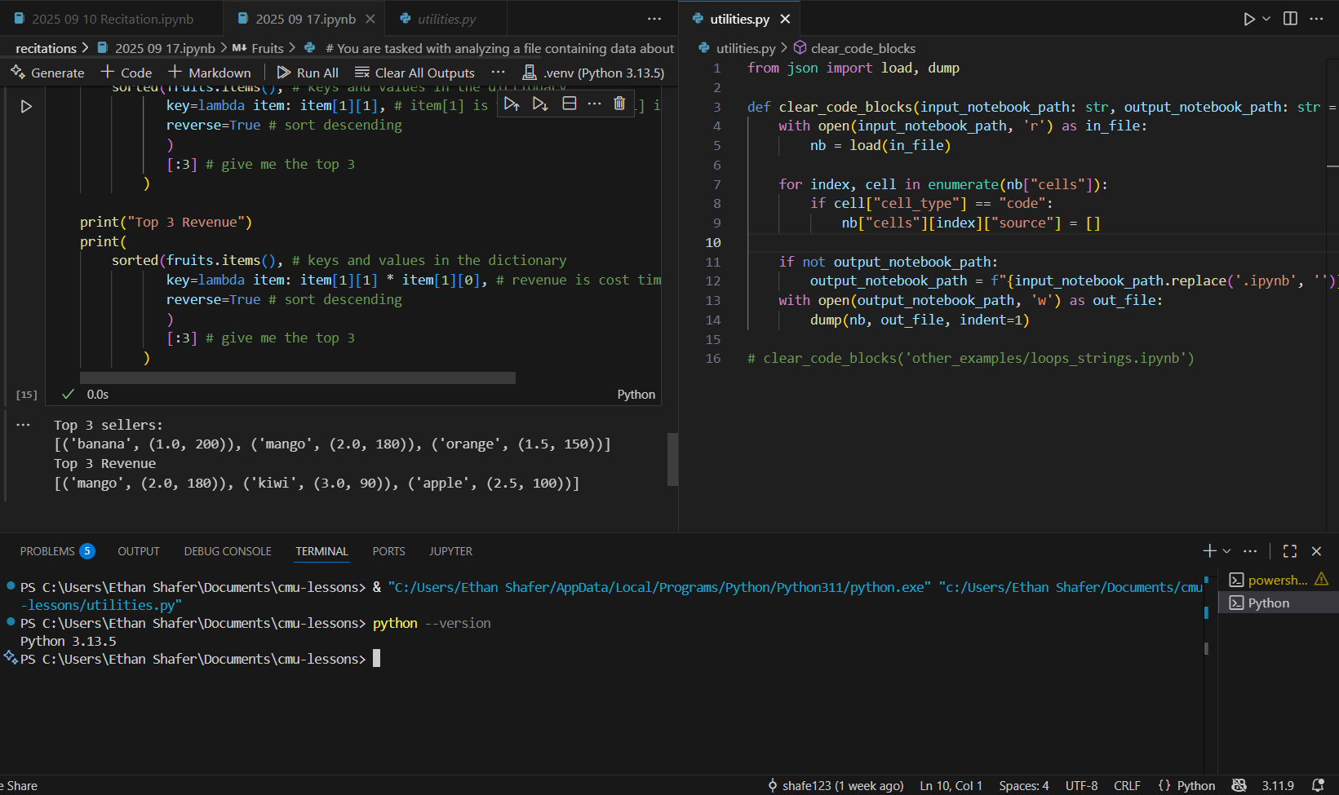
Virtual Environment…
Active Interpreter…
…PATH

Slide 14
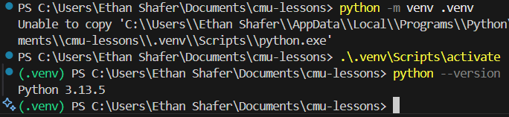
A bonus
In this example, the first command (“python –m venv .venv”) creates a virtual environment with the version of python that is first found on the PATH.

